Slide 1



1st European Meeting of Experts on Regulation o Acupuncture and TCM
State of the art in Italy
CARLO MARIA GIOVANARDI MD, ACUPUNCTURIST
Vice Chairperson of WFCMS (World Federation of Chinese Medicine Societies).
Vice President of PEFOTS (Pan European Federation of TCM Societies)
President of FISA (Italian Federation of Acupuncture Societies)
President of A.M.A.B. (Medical Acupuncturists Association of Bologna and Italian-Chinese Acupuncture School)

Slide 2
Health Regulation (1)
1978: Establishment of the National Health Service (NHS)- Legge 23 dic.1978 n.833
the National Health System aims to ensure: uniformity of health conditions throughout the national territory and guarantees to all people the uniform levels of assistance.
Notes:
National Health Service (SSN): Operating instrument to ensure the protection of health. Art. 1 Law 833 "The Republic protects health as a fundamental right and collective interest by the NHS"

Slide 3
Health Regulation (2)
the fullfilment of the National Health Service is under jurisdiction of the State and the Regions (Law 502/92 and subsequent amendments)
The National Health System draws up the National Health Plan and establishes in agreement with the Regions, the LEA- Essential Levels of Assistance (ie the medical care to be paid only by the State and the Region, among them there is also acupuncture)
The NHS operating instrument is the ASL (Local Health Authorities), inter-regional institutions which have autonomy in different areas: managerial, organizational, accounting, administrative, patrimonial, technical areas
Notes:
National Health Service (SSN): Operating instrument to ensure the protection of health. Art. 1 Law 833 "The Republic protects health as a fundamental right and collective interest by the NHS"

Slide 4
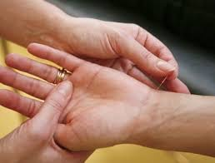
Health Regulation (3)
Statistical studies show that 14,5% of Italians use Complementary and Alternative Medicine (CAM) therapies (EURISPES, 2012)
In Italy, Acupuncture is among the most used CAM therapies;
It is increasingly provided for several diseases in conventional healthcare, both in private and public structures;

Slide 5
Requirements for access to the profession (1)
The practice of Acupuncture is considered “medical procedure”, so it can be exercised only by Doctors in Medicine and Surgery
(Court of Cassation of 1982);
FNOMCEO (National Federation of Physicians and Dentists) in 2002, reaffirms that only a physician can practice CAM:
    only a physician is able to make a diagnosis and then decide or not to set up an adequate treatment plan.

Slide 6
Requirements for access to the profession (2)
The regulation about acupuncturist training and school can be divided in two times :
before and after the Agreement for the Quality Certification of Acupuncture Training and other CAM, in the Permanent Conference State – Regions (2013)

Slide 7
Requirements for access to the profession (3)
Before the Agreement :
FISA (Italian Federation of Acupuncture societies) had a fundamental role in attempting to harmonize and unify the educational training of the acupuncturists in Italy because:
includes the largest number Acupuncture societies in Italy (about 2,000 MD)
The adhering societies can interface with the public institutions through a single organ.
In 1995 inside FISA, the FISA Associations’ Coordination of Acupuncture Schools was founded.

Slide 8
Requirements for access to the profession (4)
FISA’s educational training :
Four-years courses;
Minimum 400 hours of theoretical and practical lessons;
Annual examination for admission to the following year;
Agreed program that includes traditional and modern aspects of acupuncture;
Final discussion of a thesis;
Achieving the Italian Certificate of Acupuncture of F.I.S.A.

Slide 9
Requirements for access to the profession (5)
The Universities followed, organizing post-graduate annual courses within the Faculty of Medicine. This started in the 80s and continued up to now.
This courses were mainly informative about CAM in general and less instructive on a specific discipline (acupuncture for example).
So training in acupuncture was attributable mostly to private schools.
Until 2013 the regulation about the “training” and “practice” of acupuncture and other CAM was quite vague.

Slide 10
Requirements for access to the profession (6)
After the Agreement :
In 2013 was signed the Agreement for the Quality Certification of Acupuncture Training and other CAM, in the Permanent Conference State - Regions
Thanks to this, the doctors who want to practice as Acupuncturists in Italy must have run a specific training process nationally recognized.

Slide 11
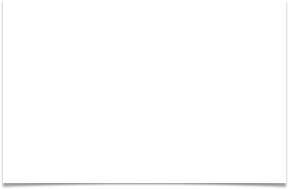
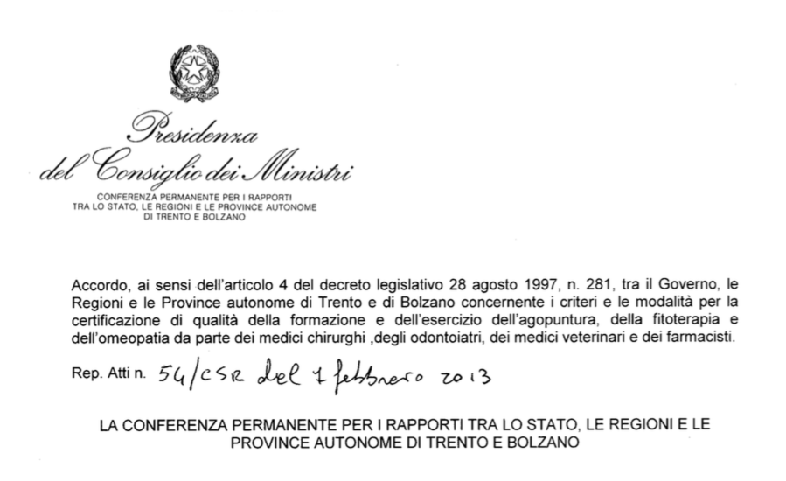
Summary of The State Regions Agreement between the Government, the Regions and the Autonomous Provinces of Trento and Bolzano
February 2013

Slide 12

Article 4
To be included in the lists of physicians and dentists who practice CAM, the student’s training must be carried out at public or private agencies accredited for training.
The training course in CAM must meet the following requirements:
At least 400 hours of theory, with 100 hours of clinical practice with at least 50% of practical training supervised by a medical expert;
At the end of each year the student has to pass a theoretical and practical exam, with the discussion of a thesis in the final year;
At the end of the training course, public and private agencies accredited for training, shall release a certificate that complies with the requirements to be included to the List of Professional Experts in the discipline;
E-learning must not exceed 30% of the total theoretical hours.

Slide 13
Article 5
Aims of the training courses
Knowledge of the fundamental principles and of the different therapeutic approaches of the discipline, considering the legal and ethical provisions related;
Study of the relationship between the discipline and the clinical methods of Western Medicine (clinical indications, therapeutic range, side effects, interactions with Western Medicine);
Develop the ability to gather and analyze elements obtained during the consultation with the patient;
Identifying and using indicators of effectiveness, cost-benefit and risk-benefit for individual disciplines.

Slide 14
Article 7
Accreditation of public and private subjects in training on CAM
Associations, scientific societies, public and private training agencies can be accredited if they employ skilled professionals with expertise in those areas.
Associations, societies, public and private institutions of education that require accreditation must be legally constituted.
Accreditation is granted by the Region of the Head Office of the school, and it has national value.

Slide 15
Article 9
Criteria to be met by the public and private agencies accredited at training and education
The Educational Manager need to be a professional subject with at least 10 years of documented clinical experience and 7 years of teaching in the specific discipline;
The professors must have attended a three years school or must have equivalent training titles, and must have gained at least 5 years of clinical practice in the specific discipline;
The accredited agencies must ensure clinical practice activities with tutors in public or private structures;
The accredited agencies must ensure in the final examination the presence of an external professional expert in the discipline, elected by Provincial Order of Medical Doctors.

Slide 16
Incorporation of Acupuncture in NHS (1)
Acupuncture is embedded within the national LEA (Essential Levels of Assistance), only for anaesthesiological purposes.
In other cases, deliverability by the Health System is different in each region.
There is great difference among Italian Regions:
- in access to acupuncture service
- in illnesses treatable by Acupuncture at the expense of the Regional Health System.

Slide 17
Incorporation of Acupuncture in NHS (1)
China and Europe Taking Care of Haelthcare Solutions 2014-2017 (CHETCH 2014-2017).
four-year project funded by the European Union which aim is to investigate the Chinese and European health with an interdisciplinary and comparative approach.
Among other things, the aim is the inclusion within European Health care Systems of Acupuncture for the treatment of some major diseases: low back pain, headaches, migraines, fertility and support to IVF (in vitro fertilization) and MAP (medically assisted procreation).

Slide 18
Others: Dry Needling an emerging problem
Dry Needling : is the insertion of acupuncture needles and their stimulation, into trigger points (ashi-points) or in other areas of the skin for the treatment of musculoskeletal disorders.
The courses provide ONLY 14-16 hours of training.
They are reserved for physical therapists without any other previous training.
In the US, the issue is very sensitive, because there were major adverse events.
Legal measures have already been made in some States.
Spokesperson is the American Academy of Medical Acupuncture (AAMA)
http://www.nccaom.org/aama-policy-on-dry-needling/

Slide 19
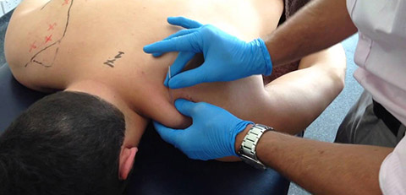
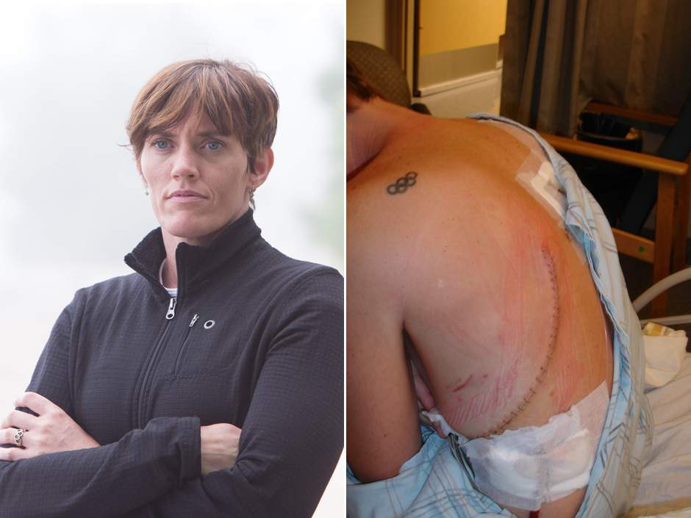
Others: Dry Needling an emerging problem
It’s really a type of acupuncture. This method is not without dangers, that are the same that can occur during a treatment with acupuncture:
1. Pneumothorax
2. Injuries internal organs
3. Injuries of nerve structures
4. Bleeding
5. Infections
6. Vegetative reactions
7. Needle breaks

Slide 20
Others: Dry Needling an emerging problem
This procedure is very painful and it is in this context can occur frequently acute complications of practice as:
          fainting with nausea, cardiovascular collapse and extreme bradycardia with vagal crisis;
          hypertensive crisis or cardiac dysrhythmias;
          triggering epileptic seizures
          it is essential to establish a correct differential diagnosis of myofascial pain (benign vs malignant)!

Slide 21

Who is qualified to practice Dry Needling?
American Academy of Medical Acupuncture (AAMA) and American Academy of Physical Medicine and Rehabilitation (AAMPR)

Slide 22
Take home messages
In Italy, the practice of Acupuncture can be exercised only by Doctors in Medicine and Surgery;
Since February 2013 training on acupuncture has a legal regulation;
Tuina practice does not require a degree in Medicine and Surgery because it is not a medical procedure;
Chinese Herbs have not a legal regulation yet.
Dry needling is Acupuncture at Ashi Points; it should be practice only by Physician/Medical Acupuncturists (in Italy) and by trained Acupuncturists in other European countries

